Slide 1
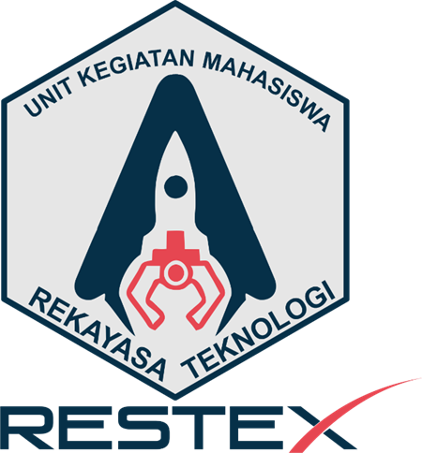

LAPORAN PERKEMBANGAN DAN KEMAJUAN KONTES ROBOT SAR INDONESIA (KRSRI) 2024 TIM GENUSIAN SAR
Nama Pembimbing:
Muchtar Ali Setyo Yudono, S.T, M.T.
Nama Ketua Tim (Mahasiswa):
Aldi Maulana (20210110056)
Nama Anggota Tim (Mahasiswa):
Faiz Muhammad Awaludin (20210120037)
Naftali Nurullillah (20220120030)

Slide 2
TABLE OF CONTENTS
01
02
DESAIN ROBOT
SISTEM KENDALI
03
04
SISTEM SENSOR
DESAIN ARENA

Slide 3
INFORMASI UMUM ROBOT
Genusian SAR adalah sebuah prototipe robot cerdas yang didesain untuk melakukan misi pencarian dan penyelamatan korban di lokasi bencana. Robot ini memiliki 6 buah kaki yang menyerupai serangga untuk berjalan dan melewati berbagai medan dengan tingkat fleksibilitas yang tinggi.

Slide 4
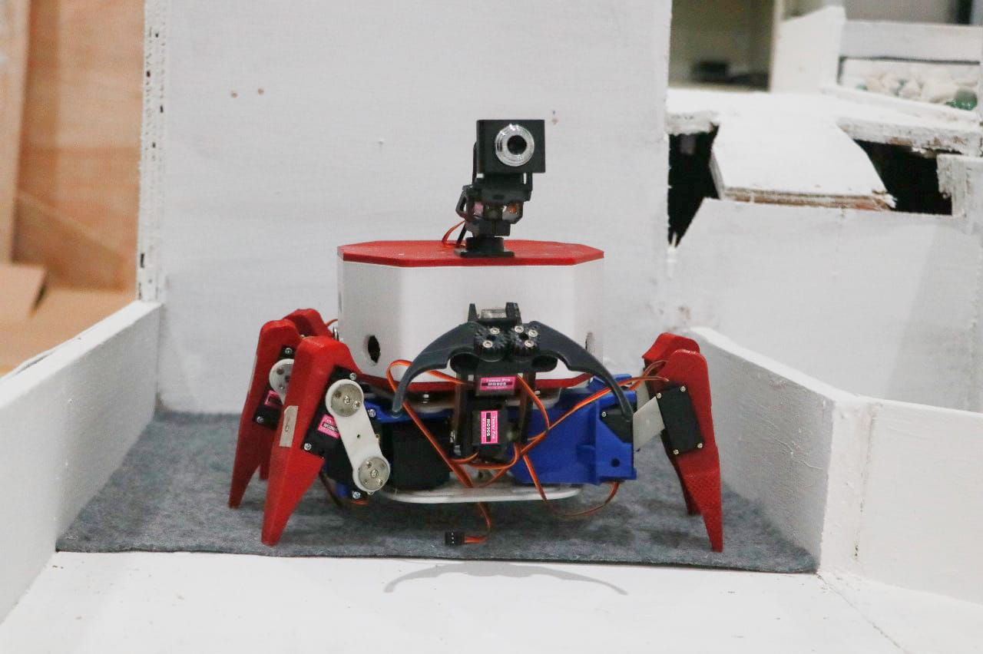
01 DESAIN ROBOT
Mercury is the closest planet to the Sun and the smallest one in the Solar System—it’s only a bit larger than our Moon. The planet’s name has nothing to do with the liquid metal since it was named after the Roman messenger god, Mercury

Slide 5
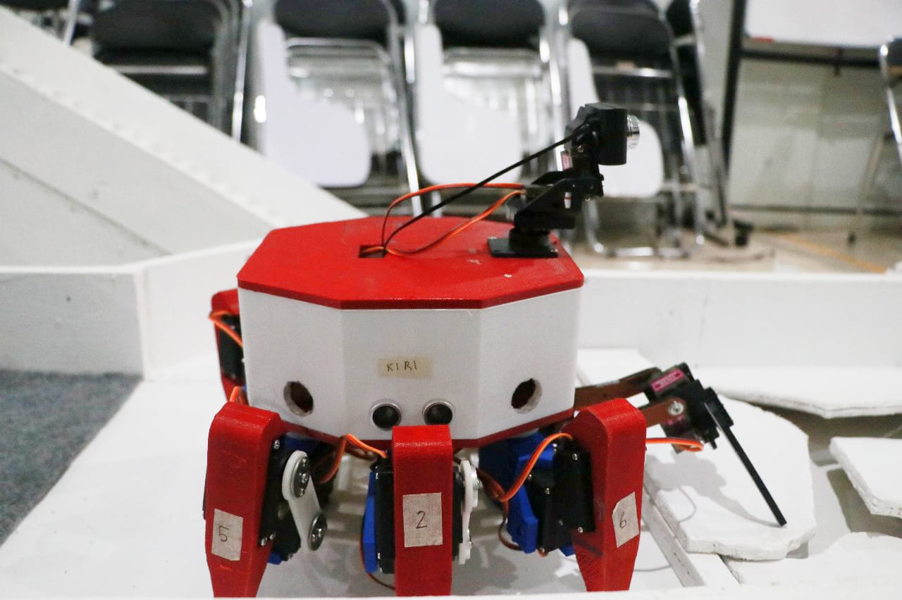
Foto robot
Tampak samping
Tampak samping

Slide 6
02 SISTEM KENDALI
Mercury is the closest planet to the Sun and the smallest one in the Solar System—it’s only a bit larger than our Moon. The planet’s name has nothing to do with the liquid metal since it was named after the Roman messenger god, Mercury

Slide 7
COMPETITIVE ADVANTAGE
THEM
US
Mercury is the closest planet to the Sun and the smallest one in the Solar System—it’s only a bit larger than our Moon. The planet’s name has nothing to do with the liquid metal since it was named after the Roman messenger god, Mercury
Venus has a beautiful name and is the second planet from the Sun. It’s terribly hot—even hotter than Mercury—and its atmosphere is extremely poisonous. It’s the second-brightest natural object in the night sky after the Moon

Slide 8
SOLUTION
Venus has a beautiful name and is the second planet from the Sun. It’s terribly hot—even hotter than Mercury—and its atmosphere is extremely poisonous. It’s the second-brightest natural object in the night sky after the Moon

Slide 9
SWOT ANALYSIS
S
W
O
T
STRENGTHS
WEAKNESSES
OPPORTUNITIES
THREATS
Jupiter is the biggest planet in our Solar System
Venus has a beautiful name, but it’s terribly hot
Neptune is the furthest planet from the Sun
Mercury is the smallest planet in our Solar System

Slide 10
PRODUCT OVERVIEW
VENUS
MERCURY
Here you can talk about the features of your product
12.06.2018
Here you can talk about the features of your product
12.06.2018

Slide 11
PLANS
You can explain your
product or your service
You can explain your
product or your service
You can explain your
product or your service
BASIC
PRO
PREMIUM

Slide 12
DEMO
Insert your multimedia content here

Slide 13

TRACTION
150,000
140,000
12,000
2,200
15
Gross revenues in 2017-2018
Average user savings per deal
Registered businesses
Daily number of users
Total app downloads
If you want to modify this graph, click on it, follow the link, change the data and replace it

Slide 14
CASE STUDY
CHALLENGE
SOLUTION
RESULTS
Neptune is the farthest planet from the Sun
Despite being red, Mars is a cold place, not hot
Venus has a beautiful name, but it’s terribly hot

Slide 15
REVIEWS
CLIENT 1
CLIENT 3
HELENA JAMES, 21
JOHN PATTERSON, 33
CLIENT 2
Here you could describe what this client said about you
JENNA DOE, 52
Here you could describe what this client said about you
Here you could describe what this client said about you

Slide 16
AWARDS
MERCURY
VENUS
JUPITER
MARS
Here you could talk about this achievement
Here you could talk about this achievement
Here you could talk about this achievement
Here you could talk about this achievement

Slide 17
MARKET SIZE
VENUS
45%
MERCURY
MARS
15%
10%
30%
JUPITER

Slide 18
TARGET
40%
60%
50,00
GENDER
AVERAGE SPEND PER CUSTOMER
INTEREST 1
20 - 35
INTEREST 2
AGE
INTEREST 3

Slide 19
COMPETITORS
NEPTUNE
Neptune is the farthest planet from the Sun
MARS
Despite being red, Mars is a cold place, not hot
MERCURY
Mercury is the closest planet to the Sun

Slide 20
BUSINESS MODEL
TRAINING
TECHNOLOGY
MARKETING
ASSESSMENT
Mercury is the closest planet to the Sun

Slide 21
TIMING
DAY 1
DAY 3
DAY 2
DAY 4
DAY 5
Jupiter is a gas giant and the biggest planet in our Solar System
Despite being red, Mars is a cold place, not hot
Venus has a beautiful name, but it’s terribly hot
Mercury is the closest planet to the Sun
Neptune is the fourth-largest planet in our Solar System

Slide 22
PREDICTED GROWTH
Jupiter is a gas giant and the biggest planet in our Solar System
Neptune is the farthest planet from the Sun
Venus has a beautiful name, but it’s terribly hot
Despite being red, Mars is a cold place, not hot

Slide 23

INVESTMENT
30%
40%
JUPITER
MERCURY
10%
20%
SATURN
VENUS
If you want to modify this graph, click on it, follow the link, change the data and replace it

Slide 24
CONTACT
Does anyone have any questions?
addyouremail@freepik.com
+91 620 421 838
yourcompany.com

Slide 25
THANKS

Slide 26
CREDITS
This is where you give credit to the ones who are part of this project.
Did you like the resources on this template? Get them for free at our other websites.
Presentation template by Slidesgo
Icons by Flaticon
Infographics by Freepik
Images created by Freepik
Author introduction slide photo created by Freepik
Text & Image slide photo created by Freepik.com

